Slide 1
Digital Twin for induction furnace IITM and SGRI

Slide 2
Objectives and Use cases
1. Develop a model to Predict various induction furnace parameters for a new heat
Before the beginning of a new heat, the model will predict refractory lining, voltage, frequency, efficiency and time of heat at the end of the heat based on input charge, tapping temperature and number of capacitors to be removed for that heat.
Use cases:
Indicate whether capacitors have to be removed at the end of heat by analyzing the electrical parameters
Analyze how efficiency changes as the number of capacitors and input charge are changed
We can identify if a patching is required after the heat which can help in planning in advance
For a selected Tapping Temperature and charge, total heat time can be estimated to know when to stop
2. Develop a model to Predict various induction furnace parameters for an entire campaign
Before the beginning of second heat of a new campaign, the model will predict refractory lining, voltage and frequency at the end of every heat of the new campaign based on the charge, temperature and capacitor removal profile and initial refractory thickness.
Use cases:
Helps in planning an entire campaign to maximize the number of heats for before lining goes off
Helps us optimize the capacitor removal to maximize heats in a campaign
Helps us decide an initial refractory lining thickness to maximize number of heats for a given charging pattern

Slide 3
Assumptions
Modelling is done with Amreli NRM Data
The capacitor value provided at every heat number is the number of capacitors removed at the beginning of that heat
If the data for number of capacitors removed is missing, then it is assumed that no capacitors are removed for that heat
Hot heel is not included in modelling as Amreli Furnace didn’t have it
Missing values are imputed with mean
The average of the top, middle and bottom diameter thickness at beginning is used as the initial thickness and similarly final thickness is computed as the furnace is cylindrical
Linear interpolation depending on the number of heats in a campaign and start and end thickness of Amreli furnace is used to obtain thickness of lining at the end of every heat
For the campaign level prediction models, input charged in every heat is assumed to be same as historical data of Amreli Furnace
If the total heat time of any heat is more than 150 minutes, the total heat time of that heat is assumed to be equal to 150 minutes

Slide 4
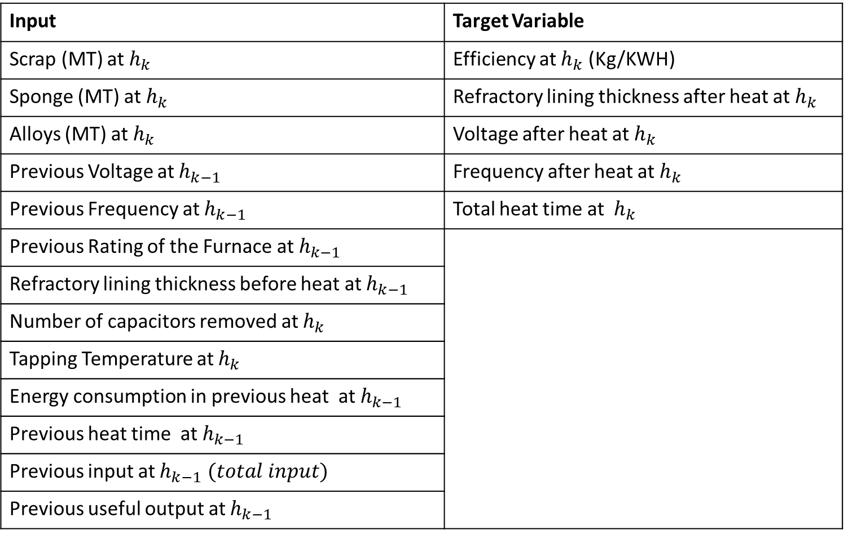
Data description – heat level model (OBJECTIVE 1)
Input | Target Variable
Scrap (MT) at $h_{k}$ | Efficiency at $h_{k}$ (Kg/KWH)
Sponge (MT) at $h_{k}$ | Refractory lining thickness after heat at $h_{k}$
Alloys (MT) at $h_{k}$ | Voltage after heat at${ h}_{k}$
Previous Voltage at $h_{k−1}$ | Frequency after heat at $h_{k}$
Previous Frequency at $h_{k−1}$ | Total heat time at $h_{k}$
Previous Rating of the Furnace at $h_{k−1}$
Refractory lining thickness before heat at $h_{k−1}$
Number of capacitors removed at $h_{k}$
Tapping Temperature at $h_{k}$
Energy consumption in previous heat at $h_{k−1}$
Previous heat time at $h_{k−1}$
Previous input at $h_{k−1} (total input)$
Previous useful output at $h_{k−1}$
Linear and Non linear models for heat
Inputs
Outputs
Note : Not all models use all inputs

Slide 5
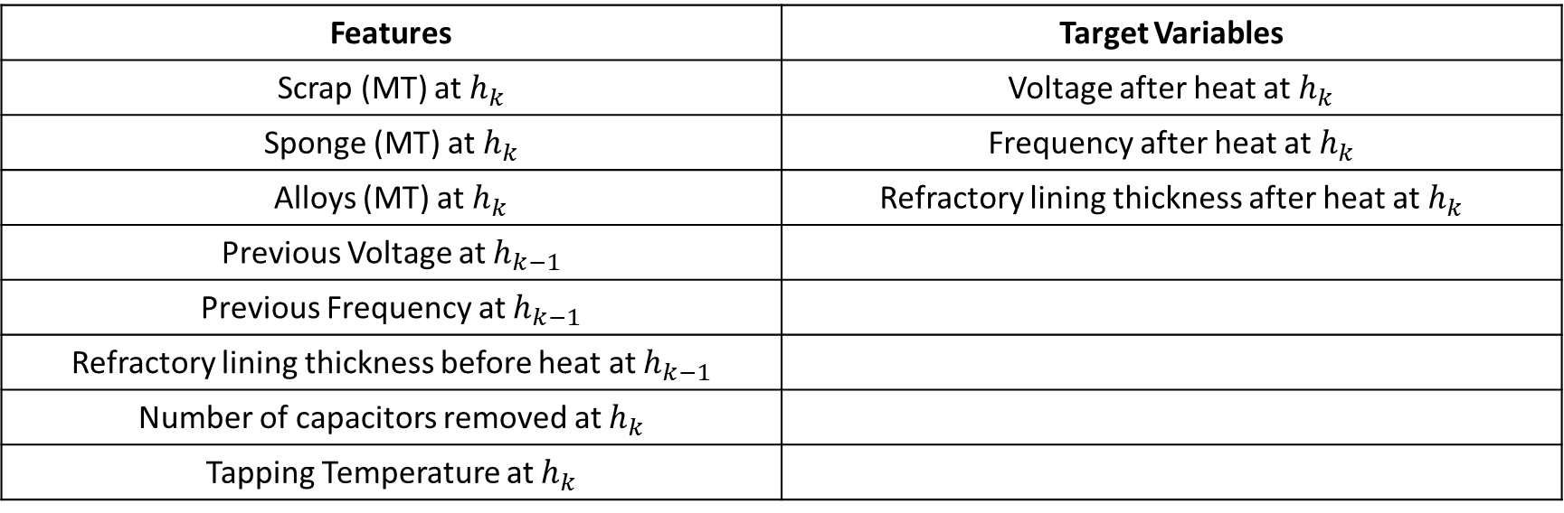
Multi-input Multi-output linear model
Features | Target Variables
Scrap (MT) at $h_{k}$ | Voltage after heat at${ h}_{k}$
Sponge (MT) at $h_{k}$ | Frequency after heat at $h_{k}$
Alloys (MT) at $h_{k}$ | Refractory lining thickness after heat at $h_{k}$
Previous Voltage at $h_{k−1}$
Previous Frequency at $h_{k−1}$
Refractory lining thickness before heat at $h_{k−1}$
Number of capacitors removed at $h_{k}$
Tapping Temperature at $h_{k}$

Slide 6
Multi-input Multi-output linear model
Model: Linear Regression
Dataset
Training data | 7 campaigns | 325 data points
Testing data | 2 campaigns | 124 data points
Target Variable | Metric | Result
Voltage | R2 score | 0.85
 | Test NMSE score | 15.2%
Frequency | R2 score | 0.95
 | Test NMSE score | 4.1%
Refractory lining | R2 score | 0.99
 | Test NMSE score | ~0%

Slide 7
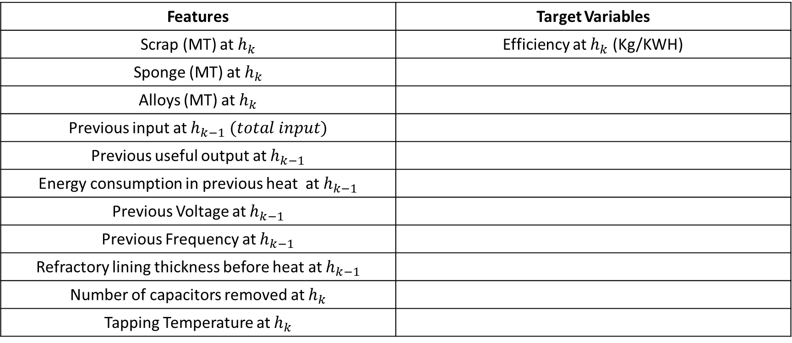
Non-linear model for Efficiency prediction
Features | Target Variables
Scrap (MT) at $h_{k}$ | Efficiency at $h_{k}$ (Kg/KWH)
Sponge (MT) at $h_{k}$
Alloys (MT) at $h_{k}$
Previous input at $h_{k−1} (total input)$
Previous useful output at $h_{k−1}$
Energy consumption in previous heat at $h_{k−1}$
Previous Voltage at $h_{k−1}$
Previous Frequency at $h_{k−1}$
Refractory lining thickness before heat at $h_{k−1}$
Number of capacitors removed at $h_{k}$
Tapping Temperature at $h_{k}$

Slide 8
Non-linear model for Efficiency prediction
Model: 3 hidden layers Neural Network
Dataset
Training data | 7 campaigns | 325 data points
Testing data | 2 campaigns | 124 data points
Target Variable | Metric | Result
Efficiency (Kg/KWH) | R2 score | -0.48
 | Test NMSE score | 148.6%

Slide 9
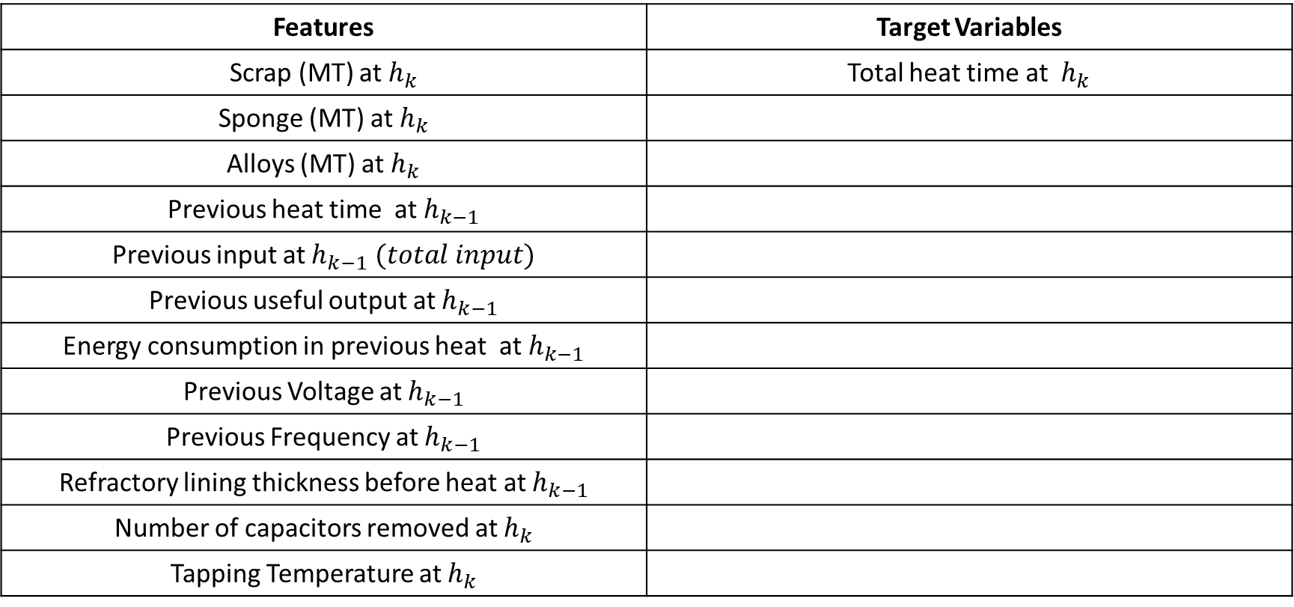
Non-linear model for total heat time prediction
Features | Target Variables
Scrap (MT) at $h_{k}$ | Total heat time at $h_{k}$
Sponge (MT) at $h_{k}$
Alloys (MT) at $h_{k}$
Previous heat time at $h_{k−1}$
Previous input at $h_{k−1} (total input)$
Previous useful output at $h_{k−1}$
Energy consumption in previous heat at $h_{k−1}$
Previous Voltage at $h_{k−1}$
Previous Frequency at $h_{k−1}$
Refractory lining thickness before heat at $h_{k−1}$
Number of capacitors removed at $h_{k}$
Tapping Temperature at $h_{k}$

Slide 10
Non-linear model for total heat time prediction
Model: XGBoost
Dataset
Training data | 7 campaigns | 325 data points
Testing data | 2 campaigns | 124 data points
Target Variable | Metric | Result
Total heat time | R2 score | 0.07
 | Test NMSE score | 92.4%

Slide 11
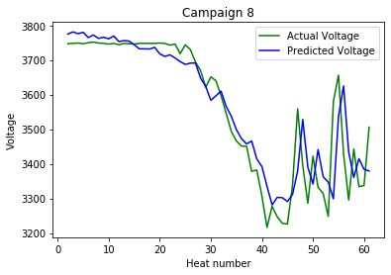
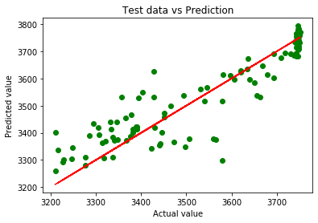
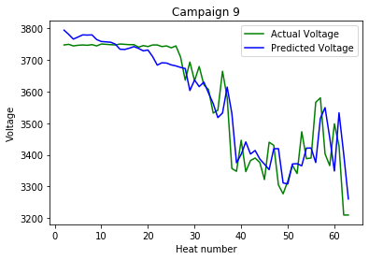
Heat level model for voltage
Predictions on 2 campaigns (test data)
Target Variable
Voltage
Metrics
R2 : 0.85
Train NMSE : 20.5%
Test NMSE : 15.2%
Model description
Linear model

Slide 12
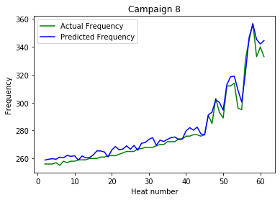
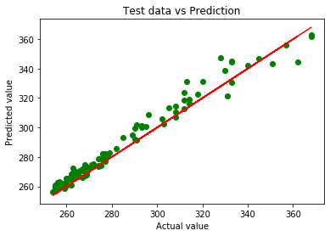
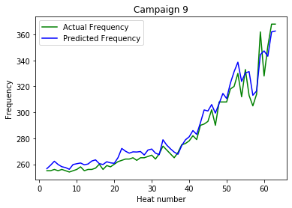
Heat level model for Frequency
Predictions on 2 campaigns (test data)
Target Variable
Frequency
Metrics
R2 : 0.95
Train NMSE : 25.4%
Test NMSE : 33.1%
Model description
Linear model

Slide 13
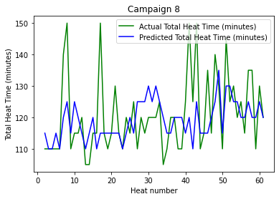
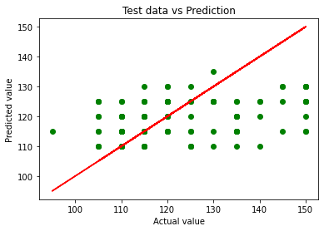
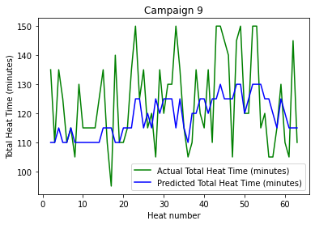
Heat level model for Total heat time
Predictions on 2 campaigns (test data)
Target Variable
Total heat time
Metrics
R2 : 0.07
Train NMSE : 9.7%
Test NMSE : 92.43%
Model description
Non Linear model
XGBoost model
Predictions rounded off to nearest multiples of 5
Outliers in data >150 min rounded off to 150 min as threshold

Slide 14
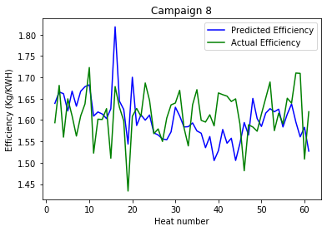
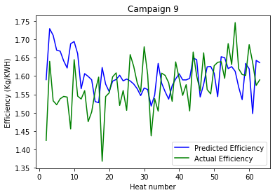
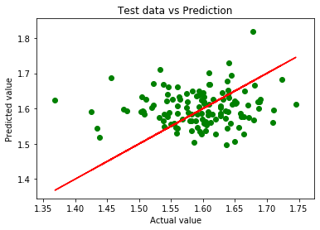
Heat level model for Efficiency
Model description
Non Linear model
3-hidden layer Neural Network
Predictions on 2 campaigns (test data)
Target Variable
Efficiency (Kg/KWH)
Metrics
R2 : -0.48
Train NMSE : 41.68% Test NMSE : 148.6%
Test NMSE : campaign 8 : 147.3% Test NMSE : campaign 9 : 168.1%

Slide 15
Limitations and scope for improvement
Heat Level Models:
The one step ahead predictions for voltage and frequency are good assuming a linear profile on the refractory lining.
The performance of model can be improved with other profiles and knowing the dependence of refractory lining to other parameters for efficiency prediction
Capacitor removal has a big influence on voltage and frequency profile but the data is unavailable in most cases, hence we aim to look at ways to incorporate the information
Models for prediction of efficiency are able to capture some trends but not the complete picture accurately. We believe the reason to be both data insufficiency and requirement to include First Principles based knowledge. For instance, the power consumption is also dependent on the temperature of charge input, temperature of the cooling jacket and coil as well. Like wise, refractory profile has an impact on efficiency. So a better profile could help.
More analysis on features affecting the heat time can help build a better model for heat time as well.

Slide 16
Campaign level predictions for frequency, voltage and refractory profile
Input | Target Variable
Scrap (MT), Sponge (MT), Alloys (MT) Profiles Initial voltage Initial frequency Initial refractory thickness Capacitor removal profile for any number of heats in a campaign Tapping temperature profile (could be constant value) | Voltage, Frequency and refractory lining profile for the entire campaign
One linear model where capacitors are not removed One linear model where capacitors are removed (Switching models)
Metrics when test data is Campaign 8 | Voltage : R2 : 0.76, NMSE : 23.33% Frequency : R2 : 0.93, NMSE : 6.96% Refractory lining : R2 : 0.83, NMSE : 16.11%
Metrics when test data is Campaign 9 | Voltage : R2 : 0.61, NMSE : 38.83% Frequency : R2 : 0.93, NMSE : 6.81% Refractory lining : R2 : 0.79, NMSE : 20.86%
Two Linear models for heat
Inputs
Predicted Output

Slide 17
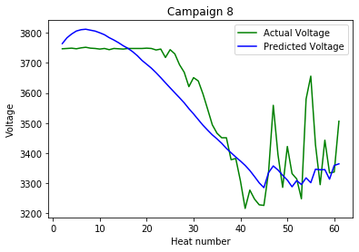
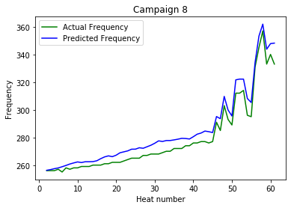
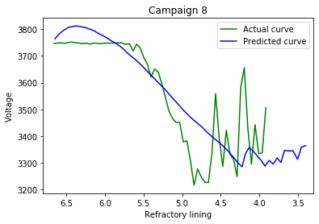
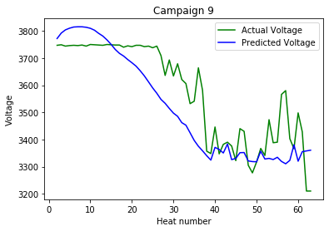
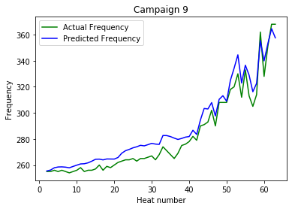
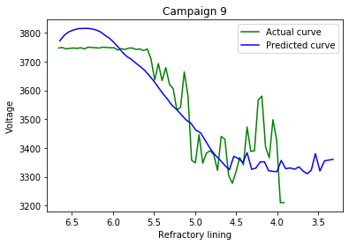
Complete campaign prediction

Slide 18
Limitations and scopes for improvement
Campaign Level Models:
Prediction of entire campaign voltage and frequency is performed. It is observed that the model for frequency prediction is good. The model for voltage shows a decreasing trend as expected. Better refractory profile could help in obtaining better models as refractory prediction is fed into campaign voltage predictions. More clarity on capacitor removal data should help.
We aim to look at including features to improve the voltage simulations in a better fashion and also explore other models.
We also aim to come up with a campaign predictive model for efficiency as well so that it can be a simulator to predict efficiency for different input profiles.

Slide 19
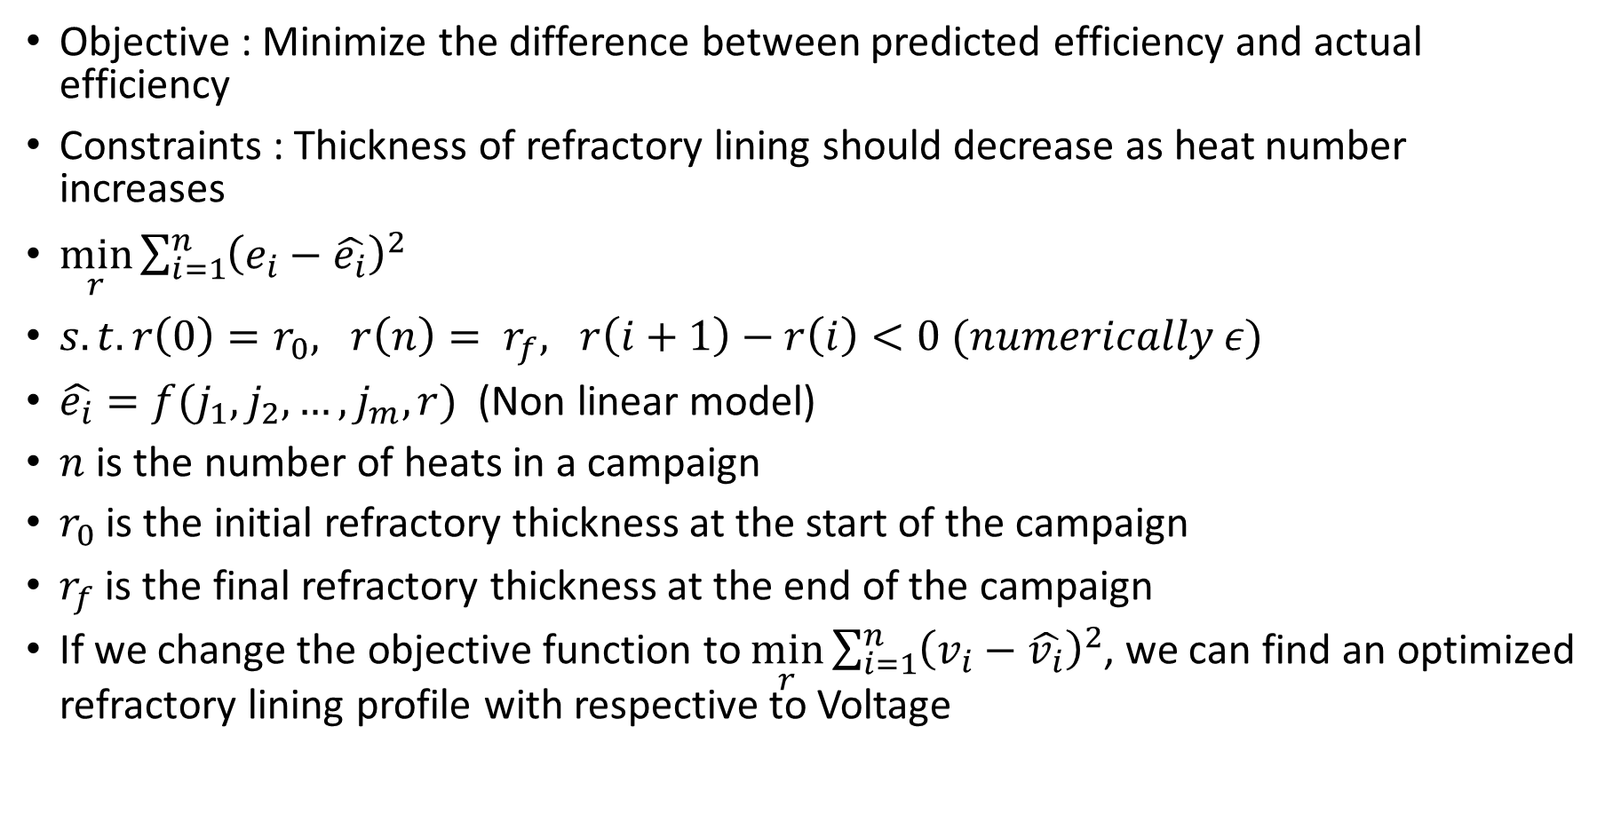
Optimization framework for refractory profile prediction
Objective : Minimize the difference between predicted efficiency and actual efficiency
Constraints : Thickness of refractory lining should decrease as heat number increases
$\min_{r}\sum_{i=1}^{n}{{\left(e_{i}−\hat{e_{i}}\right)}^{2}}$
$s.t. r\left(0\right)=r_{0}, r\left(n\right)= r_{f}, r\left(i+1\right)−r\left(i\right)<0 (numerically ε)$
$\hat{e_{i}}=f(j_{1},j_{2},…,j_{m},r)$ (Non linear model)
$n$ is the number of heats in a campaign
$r_{0}$ is the initial refractory thickness at the start of the campaign
$r_{f}$ is the final refractory thickness at the end of the campaign
If we change the objective function to $\min_{r}\sum_{i=1}^{n}{{\left(v_{i}−\hat{v_{i}}\right)}^{2}}$, we can find an optimized refractory lining profile with respective to Voltage

Slide 20
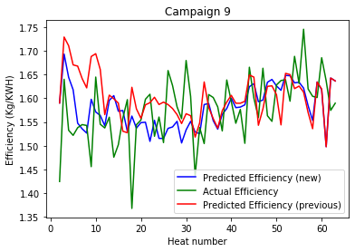
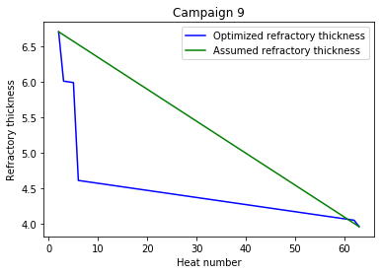
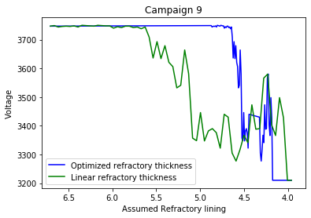
Results : Optimization on test data campaigns (w.r.t efficiency)
Inferences:
With linear interpolation, NMSE obtained is 168 % where as NMSE obtained is 114.3% with optimized refractory lining
A different refractory lining profile improved efficiency predictions for the same model which indicates that the actual refractory lining profile is different from the linear profile we assumed
Even after giving the optimal refractory profile as an input to the model, the predictions are not accurate which indicates that there are additional features that affect efficiency
Note: Depending on initial refractory lining profile, locally optimal solutions were obtained

Slide 21
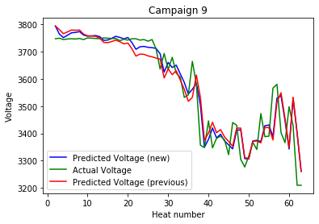
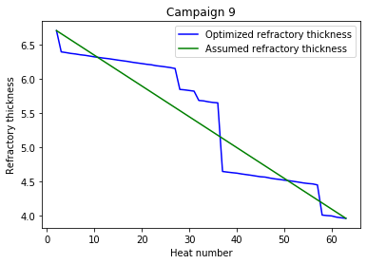
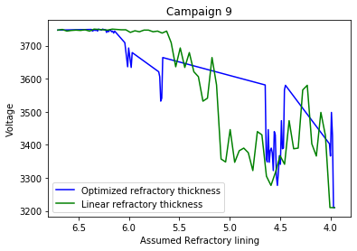
Results : Optimization on test data campaigns (w.r.t Voltage)
Inferences:
With linear interpolation, R2 score obtained is 0.85 where as R2 score obtained is 0.88 with optimized refractory lining
A different refractory lining profile improved voltage predictions for the same model which indicates that the actual refractory lining profile is different from the linear profile we assumed
We can clearly see that after a few heats in the campaign, lining thickness drops suddenly as expected
Note: Depending on initial refractory lining profile, locally optimal solutions were obtained

Slide 22
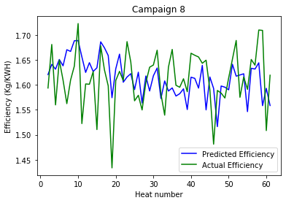
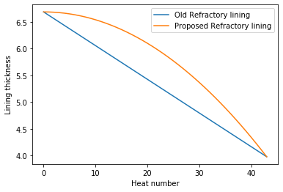
Efficiency prediction with quadratic refractory lining
With linear interpolation
With quadratic interpolation
Test NMSE : campaign 8 : 147.3%
Test NMSE : campaign 8 : 114.2%

Slide 23
Summary
Heat level and campaign level predictive models were built for voltage and frequency prediction
Models for efficiency and total heat time has to be improved for accurate predictions by incorporating more features, data and better understanding of the refractory profile.
An optimization problem was solved to identify the best refractory profile to minimize error in efficiency prediction and voltage prediction
Questions to SGRI
Information on number of capacitors available for a furnace, how many can be removed at a time and the maximum capacitors that can be removed.
Furnace capacity details for campaign level predictions and for when multiple furnaces are modelled
Can we obtain information related to coil temperature measurements, cooling jacket temperature or input feed temperature?

Slide 24
Project phase 1 timeline
Date | Members | Discussion | Outcome
26-08-2020, Friday | IITM : Raghunathan Rengaswamy, Bala Shyamala, Sai Nikhil SGRI : Prasanth, Srijith, Karthik | Kick off meeting | Preliminary discussion on the proposal and confirmation of SGRI to provide data to IIT - M
03-09-2020 | EMAIL correspondence | Received data from SGRI | IIT M team started looking at the data. SGRI planned a meeting to discuss the data details
15-09-2020 | IITM : Raghunathan Rengaswamy, Bala Shyamala, Sai Nikhil SGRI : Prasanth, Srijith, Karthik | Had a first discussion on the data | IITM team studied the data from the discussion outcome and came up with more questions on the data.
16-09-2020 | IIT-M internal meeting
19-09-2020 | IITM : Raghunathan Rengaswamy, Bala Shyamala, Sai Nikhil SGRI : Prasanth, Srijith, Karthik | Discussed the data in detail to understand the meaning of columns and data description completely | Having clarified about the data, we started looking at models for the data.
23-09-2020 | EMAIL correspondence | Received data of one more customer and refractory lining data. | Added to our analysis
27-09-2020 | EMAIL correspondence | Required some clarifications on process mechanism and terminologies | Received clarifications from SGRI regarding the same.
27-09-2020 | IIT-M internal meeting | Detailed discussion and visualization of the data | Idea for model building and project requirements
03-10-2020 | IIT-M internal meeting | Discussion on models from data. This brought in question on the variables that can be manipulated and needs to be controlled and details of the physical process | A plan for another meeting with SGRI to clarify our doubts on the process.
07-10-2020 | IITM : Raghunathan Rengaswamy, Bala Shyamala, Sai Nikhil SGRI : Prasanth, Srijith, Karthik | Discussion about the process in detail with the constraints on various variables in the process | Got a clear picture of the problem and objective to start the modelling
08-10-2020 | IIT-M internal meeting | Discussion on the different models that can be built | A clear picture with objectives to start the modelling exercise.
16-10-2020 | IIT-M internal meeting | Preliminary results discussion | Plans to take the modelling exercise forward
21-10-2020 | IIT-M internal meeting | Discussion about models built | Plan for a predictive model with specific use cases
27-10-2020 | IIT-M internal meeting | Discussion on the models built and presentation slides for phase 1 of project | Discussion on slides for presentation, optimization framework for identifying optimal refractory profile
30-10-2020 to 28-11-2020 | Tasks for next month Verification of the simulation results Identifying techniques and ideas that can be pursued to improve predictions Writing a project report and sharing the code package Identifying use cases that will be pursued in phase 2 Generation of a phase 2 proposal and share

Slide 25
THANK YOU

